Slide 1

BRUTE FORCE
LONG CHICKEN STYLE
Created by:
Talbot Taylor, Branden Applewhite,
Jason Inirio, Arnav Gupta
Notes:
Arnav - everybody says names

Slide 2
Goal/Motivation
Create game that can be displayed on VGA with a “nostalgic” feel
Make a fighting game that emulates boxing robots in the future
Build upon functionalities used in previous labs and put them all together
Incorporate other classes curriculum with game mechanics
Notes:
Arnav

Slide 3
Functionality
Start menu before fighting
Take input control from user through keyboard
Process input to decide whether user will land punch or not
Have computer controlled opponent for player to fight
Have background (“fight”) music playing
Output still images and animations through VGA for better UX
End battle after timer ends or health depletes
Notes:
Arnav

Slide 4
Specifications
Keyboard (PS2)
User Input (Only one input)
Audio Amplifier (w/ Earphones)
Background Music
VGA Display
Display Game Elements (Health, Fighter Animations and Stills)
Game Mechanics
LFSR, Different Clock Implementation, Probability of Punch Landing
Seven Segment Display
Time Remaining
Notes:
Branden

Slide 5
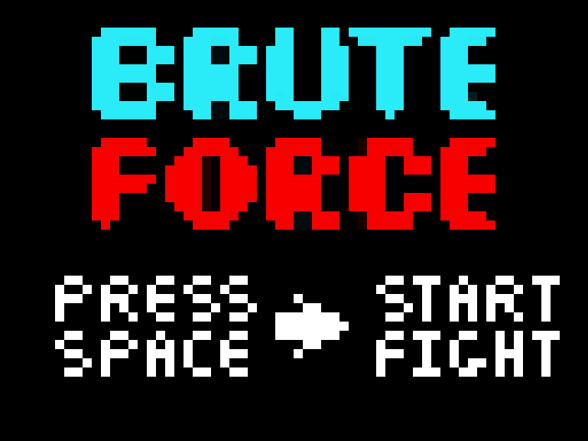
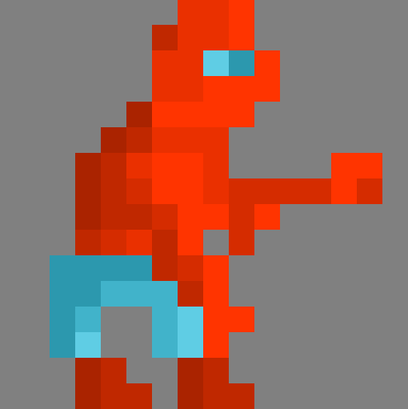

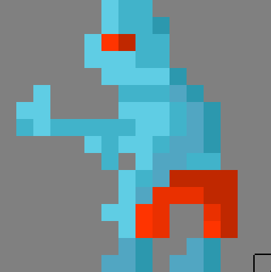
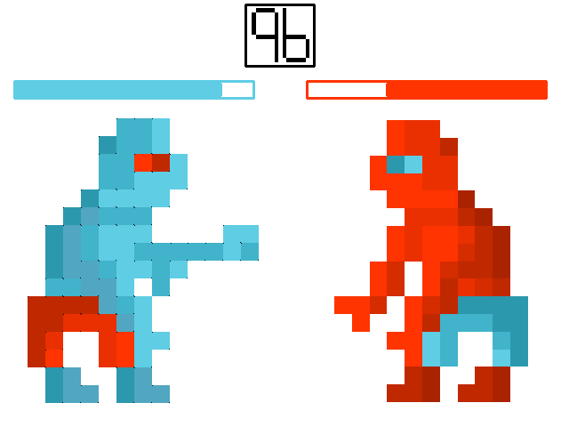
Force
Brute
Notes:
Talbot

Slide 6
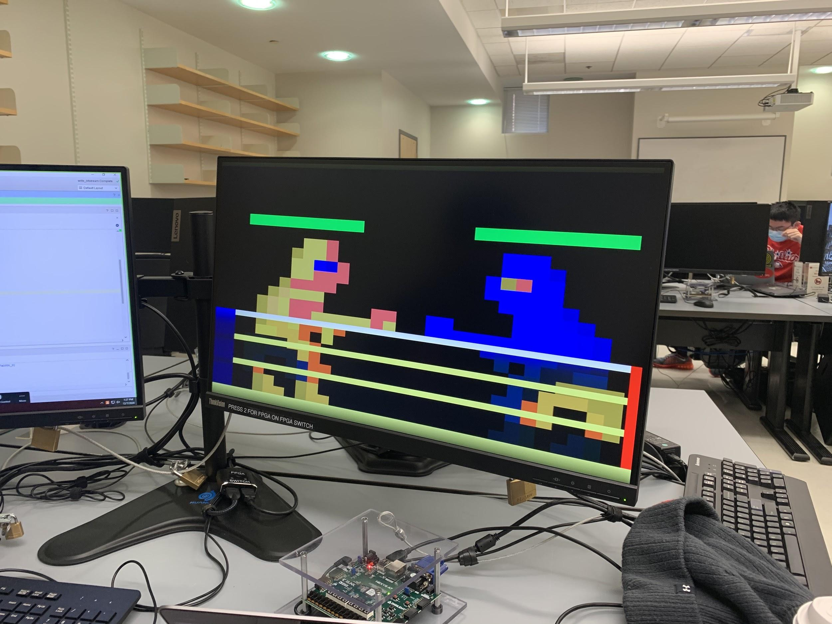
Current VGA Display
Notes:
Talbot

Slide 7

Keyboard Demo
Notes:
Arnav

Slide 8
Block Diagram
Notes:
Jason

Slide 9
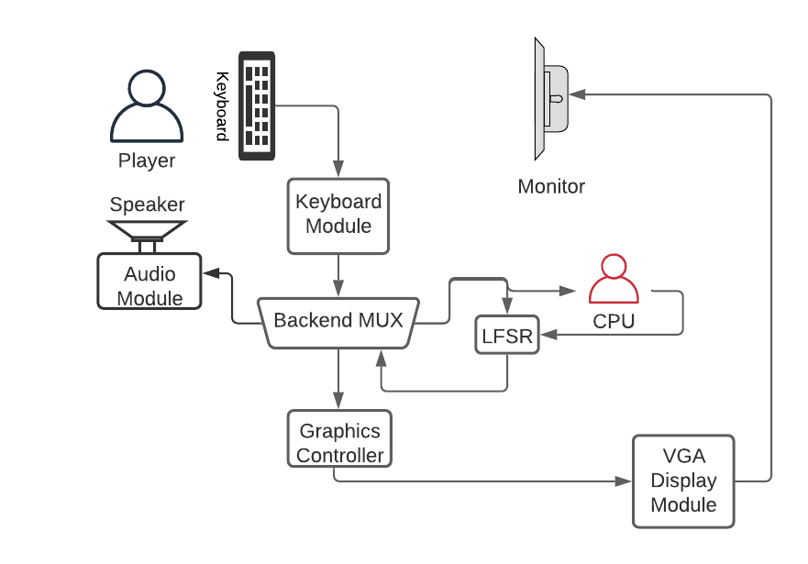
Block Diagram - General Functionality
Notes:
Jason

Slide 10
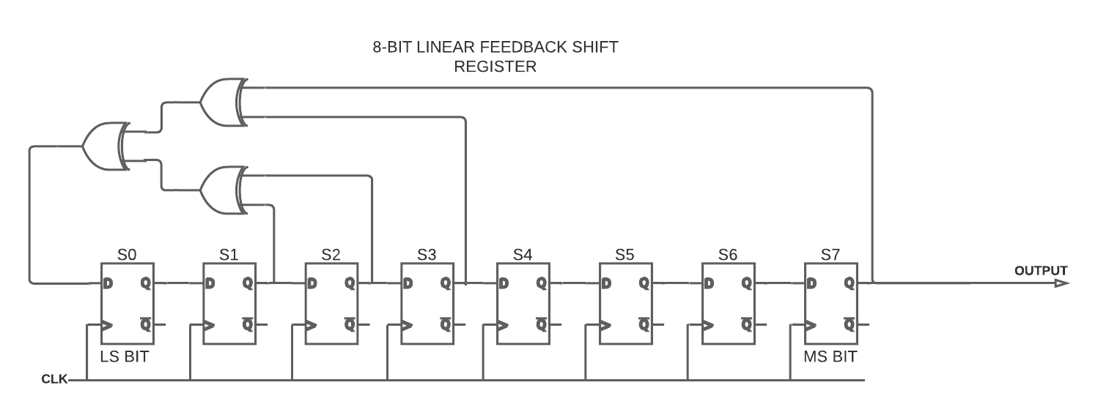
Block Diagram - LFSR Diagram
Notes:
Jason

Slide 11
Source Code
Notes:
Branden

Slide 12
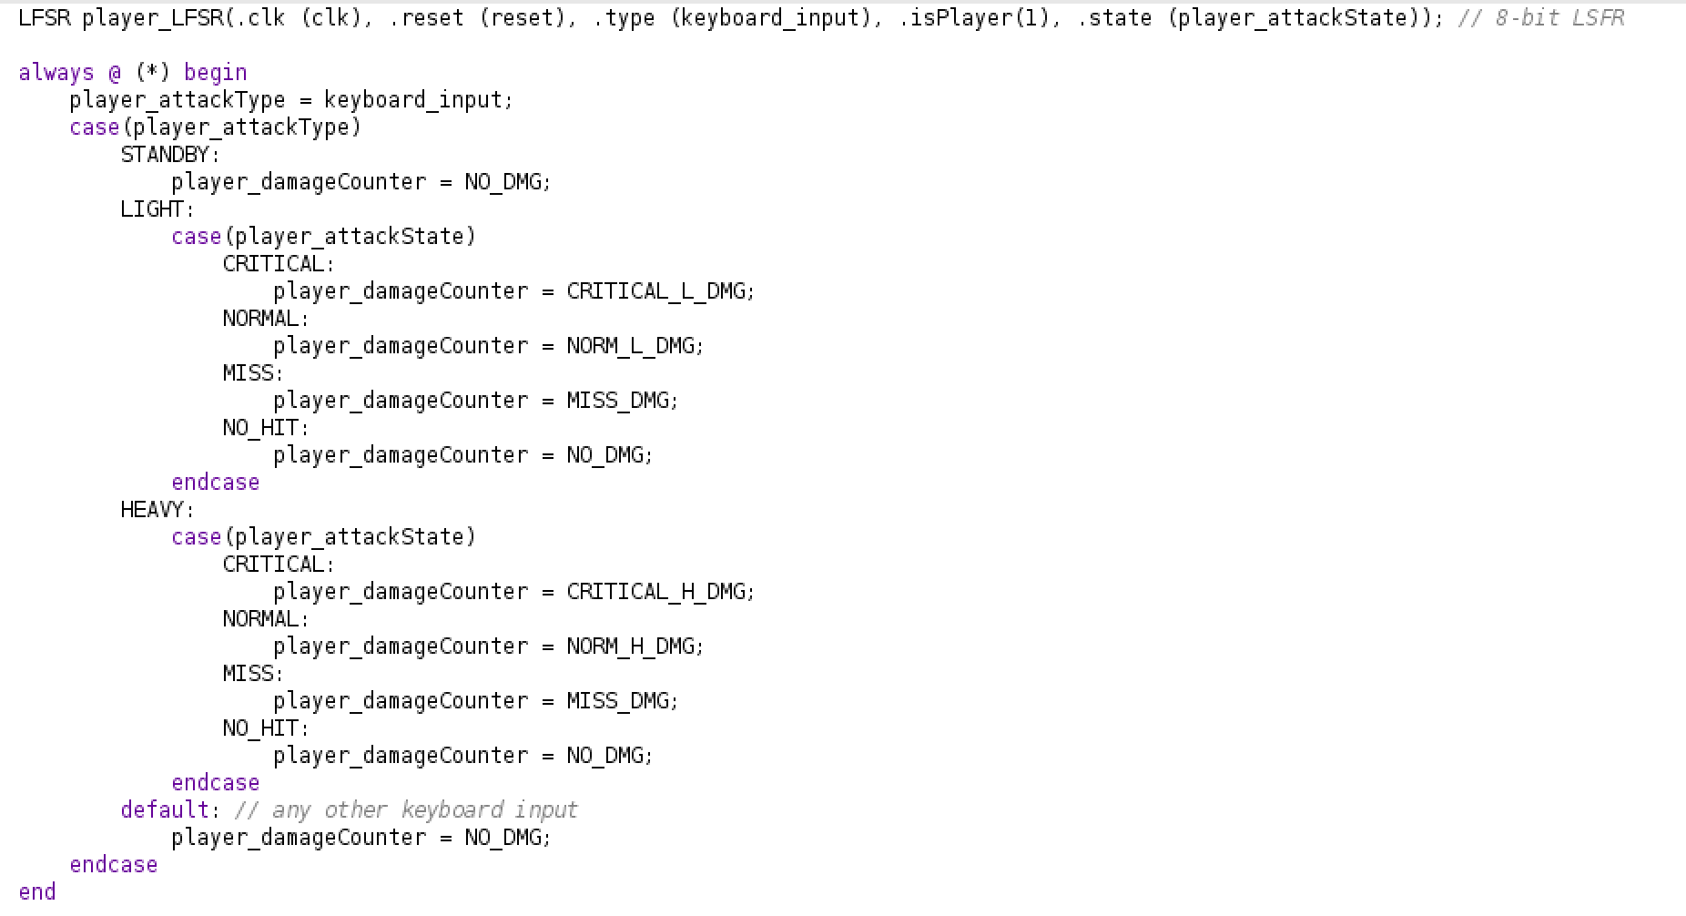
Code Snippet - Backend Mux and LFSR
Notes:
Branden

Slide 13
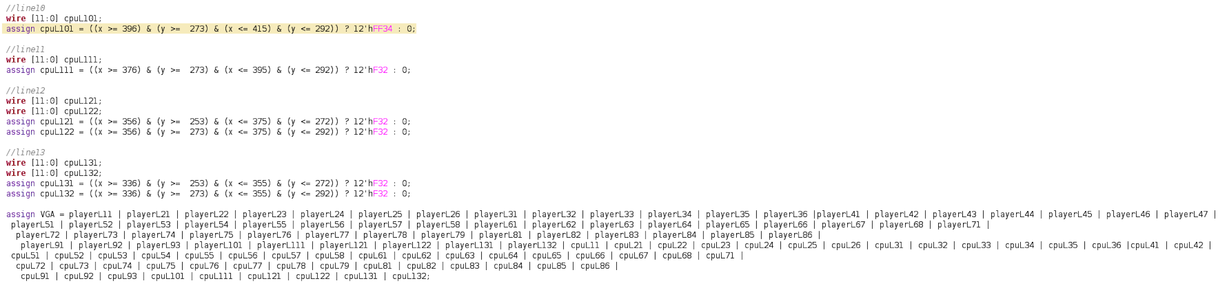
Code Snippet - VGA Implementation
Notes:
Talbot

Slide 14
Successes
Able to input 4 bit value from keyboard
Able to use Audio Amplifier
Uses LFSR to successfully generate random numbers
Able to output on VGA display with animated sprites
Notes:
Talbot

Slide 15
Failures
Unable to implement two player functionality
PS2 input allows one input at a time per port
Unable to import MP3 file for music
Difficulty implementing the VGA for more complex art
Spent a lot of time on implementation that did not work
Attempt to automate the sprite process
Cannot find accurate way to convert standard RGB codes to 12 bit register
Glitch where colors turn darker after a certain y-axis position
Notes:
Branden

Slide 16
Thank you! Any Questions?
Notes:
Everybody

